Slide 1
Jacksonville Waterways Commission
Sub-Committee
on
Potential Slow Speed/Minimum Wake Zone Sites
Commissioner Jill D. Haskell
Jan 22, 2021

Slide 3
Courtesy,…..I would like to see more courtesy. Peggy Sue Williams, Lamb’s Yacht Center
The Reasons for visiting this issue NOW:
The needs of the Boating Community have changed.
There is more of a variety of boats out there.
2) The Waterways are more Congested than ever.
New boat sales rise every year & marinas are crowded.
3) There are more New Boaters on the Water.
First time boaters are a large part of the growing market.
There are more people moving into FL that want the lifestyle.
For example, look at the growing number of waterfront homes.
5) Calls have been coming into COJ Depts. concerning this matter.

Slide 4
Areas of Concern
St Johns River at Mayport Boat ramp
(inclusive of Morningstar and Ft George Island Marinas)
Ft George River from the Kingsley Plantation to the A1A bridge
3) Arlington River from mouth of Arlington to Pottsburg Creek/Atlantic Blvd Bridge
4) Ortega River, from the Grande Ave Bridge to Lake Shore Dry Storage
Waters surrounding Reed Island
Trout River at Dinsmore Boat Ramp

Slide 5
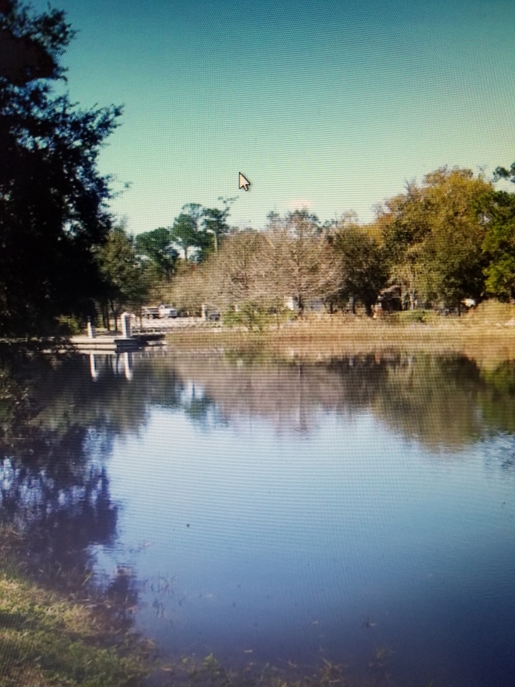
*Disqualified Area as pertaining to requirements set forth in Chapter 327 Section 46
Dinsmore Boat Ramp
Dinsmore Boat Ramp
Not a congested area
Not a high velocity tidal area
Not lacking facilities to handle traffic
No enforcement issues

Slide 6
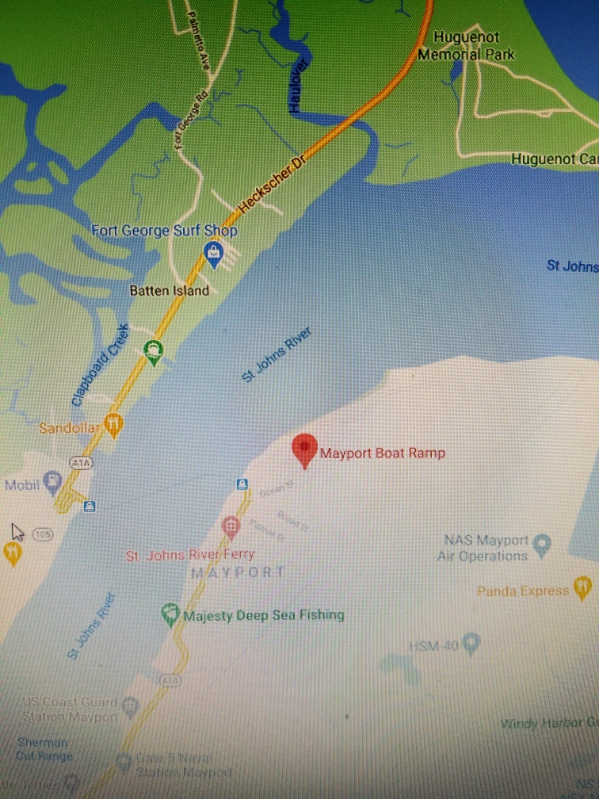
Disqualified Areas
St Johns River at Mayport Ramp
This area is adjacent to a Federal Channel, therefore a restricted zone would not be granted.
Some wake would be produced to maintain proper steerage at times.
Waters Surrounding Reed Island
There is no current activity there that would require a restricted zone. Also, this is an area where slow speed could hamper proper steerage.

Slide 7
Disqualified Area
Arlington River/Pottsburg Creek
The only light congestion in the area has co-existed for decades (rowing teams and recreational boaters)
There has been no new infrastructure ie., bridges
No enforcement actions in the area
It is a very popular skiing area for generations
The residents in this area are against any restriction

Slide 8
The State of FL can issue a restricted zone by Rule and/or COJ can issue a zone by Ordinance

Slide 9
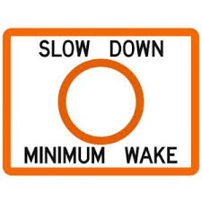
Areas Needing Attention
Ortega River : Described as unorganized, congested, vulnerable, unenforced and needs more marking.
Ft. George River: Described as dangerous, congested, unpredictable and needs at least seasonal restrictions

Slide 10
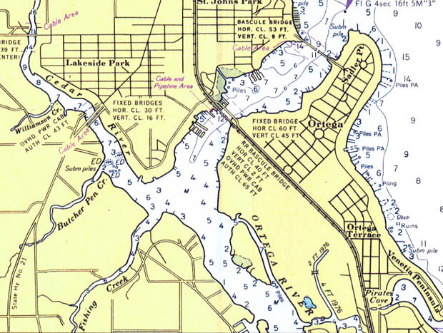
Ortega River
Grand Ave Bridge
Lake Shore
Dry Storage

Slide 11
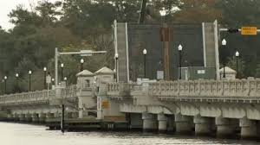
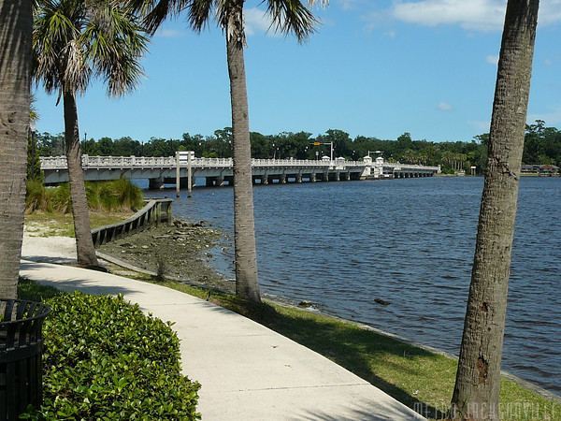
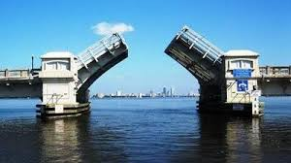
Ortega River Grand Avenue Bridge to Lake Shore Dry Storage

Slide 12
Lake Shore Dry Storage

Slide 13
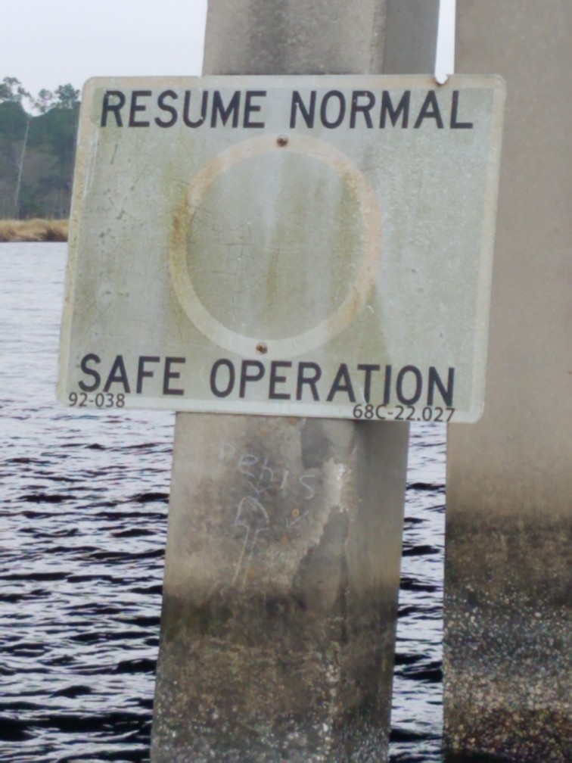
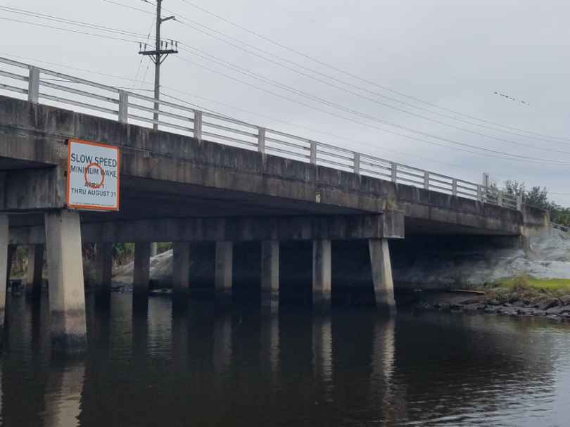
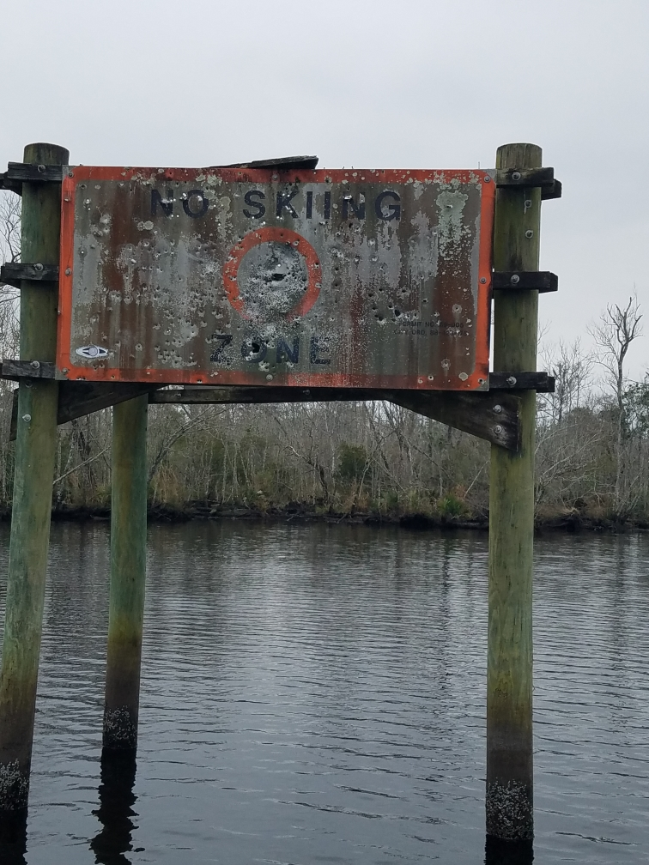
Examples of Signage in Ortega River Area

Slide 14
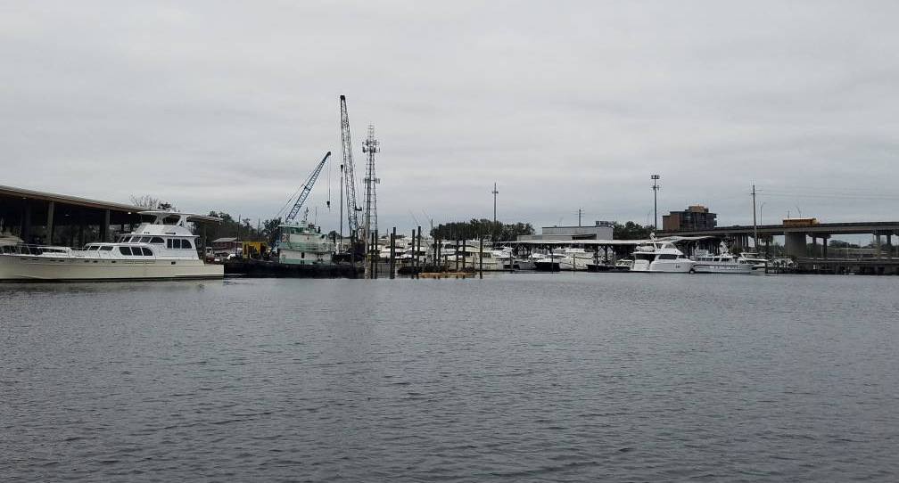

Slide 15
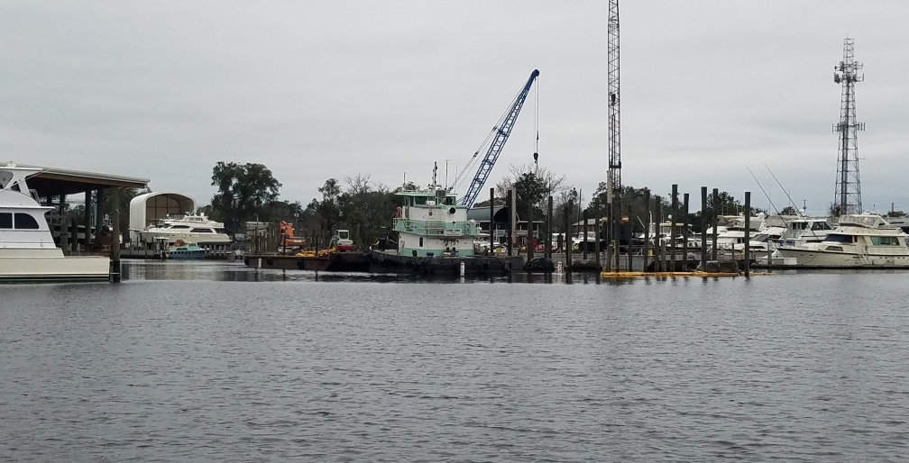

Slide 16
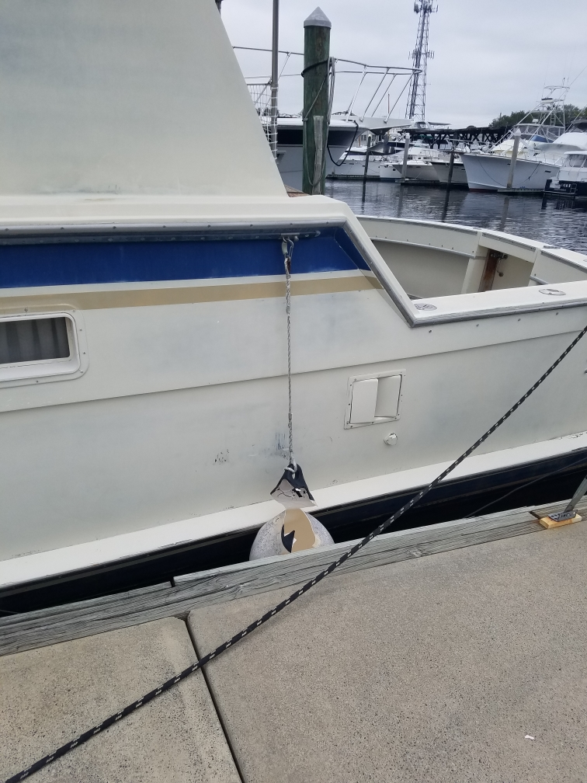
Damages to Docks and Vessels
Ortega Landing reports over 100K floating dock damage in 36 months from wave action
Liveaboards experience severe rocking at all hours of the day and night
Alcohol related incident caused 21CC to hit bridge and run onto shore last year
Large boats have reportedly crashed into concrete docks because of wakes from passing vessels

Slide 17
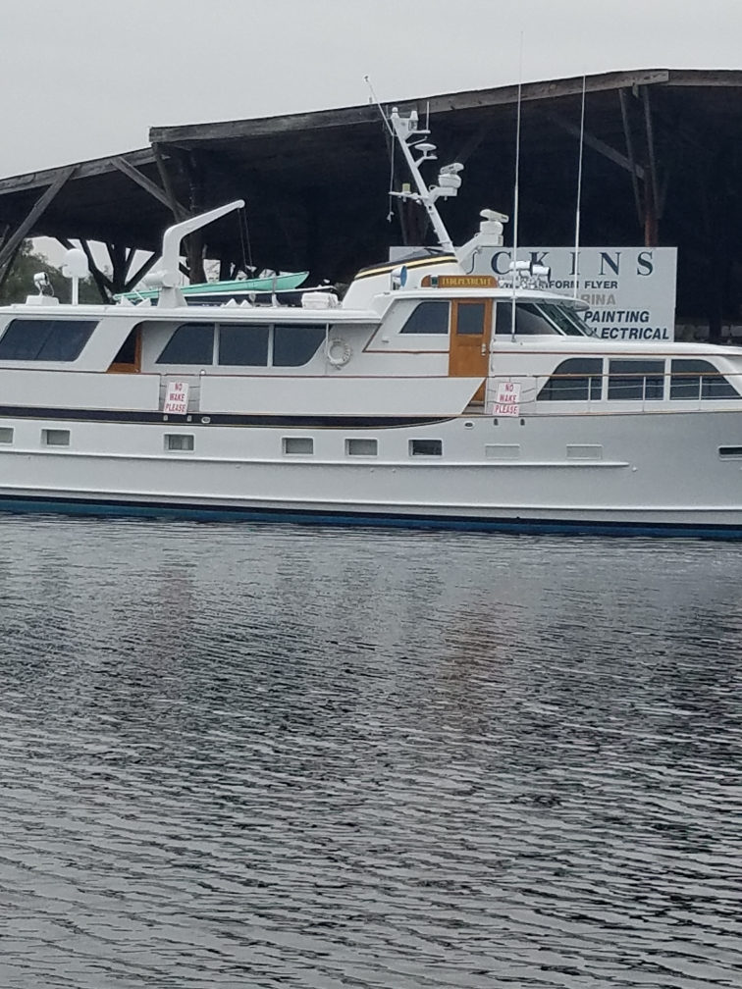
Boaters are Asking for
HELP!!!

Slide 18
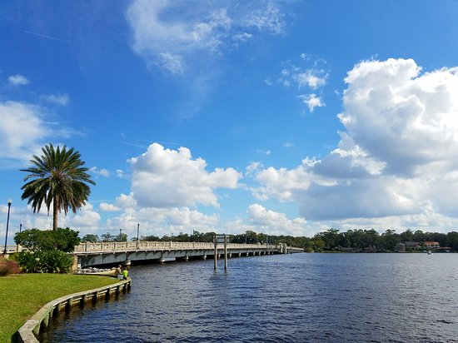
INPUT FROM THE COMMUNITY
Marina Operators, Boat Owners and Homeowners are asking for this:
More Enforcement of Existing Zones
More Organization of Channel and Markings
Mooring Field near Stinson Park
Possible Marking of Activity Zones. Such as skiing, cruising, wake boarding
Enforcement During Weekdays & Evenings

Slide 19
What are your suggestions?

Slide 20
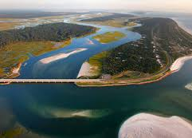
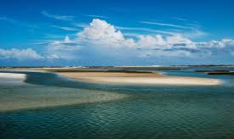
Ft George River
A Local Paradise

Slide 22
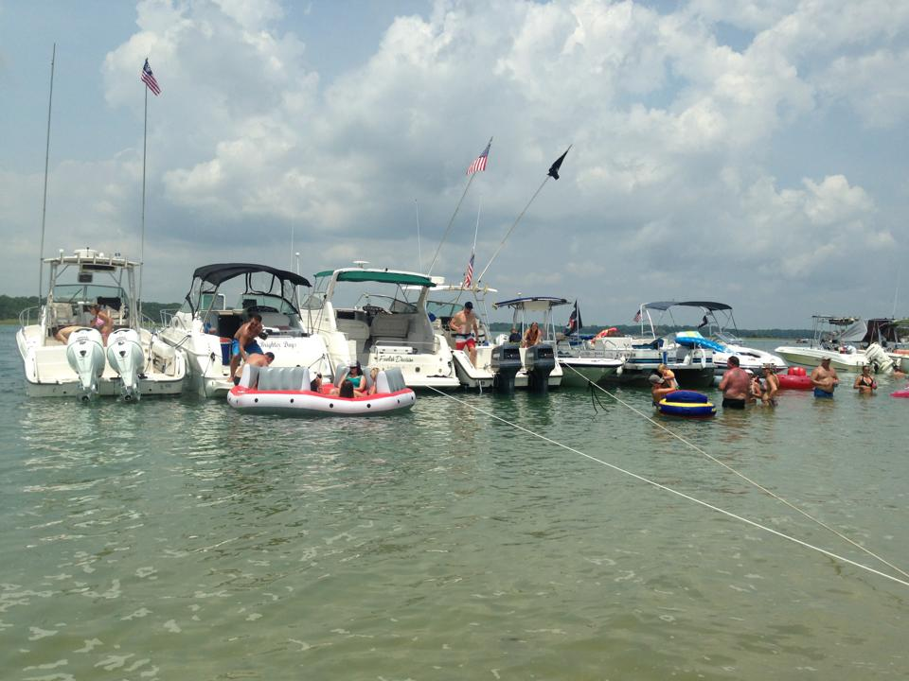
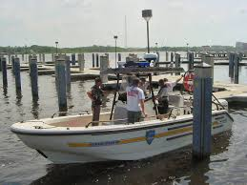
Enforcement Actions Highlight Specific Issues:
Operator safety issues
Alcohol a common factor
Vessel damage occurring
Collisions between vessels and fixed objects are common
Jet Ski falls cited

Slide 23
Possible Solutions

Slide 24
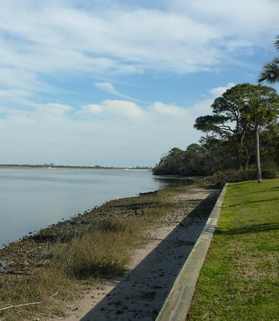
*Restrictive Zone Beginning at Kingsley Plantation Ending at the A1A Bridge Note: Crystal River has a seasonal no wake zone…Oct 1 to April 1st , on weekends and holidays.
Possible Solutions to the Safety Issues in Ft. George Inlet

Slide 25
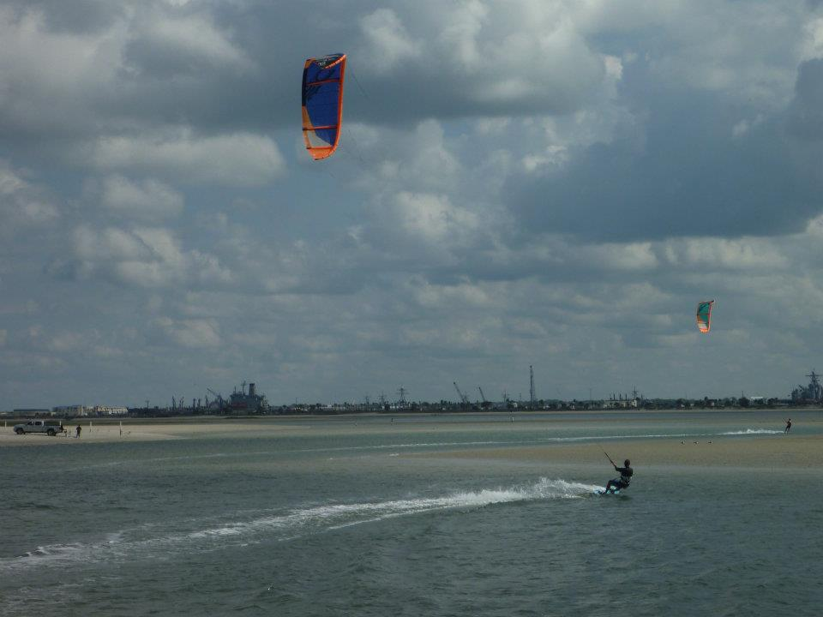
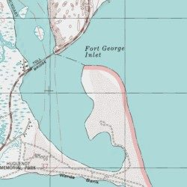
Image Taken September 2012

